Slide 1
Amazon Web Services F1 Instance
Reconfigurable Computing
By,
Medini J. Aradhya

Slide 2
Description :
The amazon web services cloud platform is compatible with existing FPGA algorithms hence makes it a versatile open source platform for accelerated computing.
Xilinx FPGAs are available in the Amazon Elastic Compute Cloud (Amazon EC2) F1 instances.
F1 instances are designed to accelerate data center workloads.
With F1 instances you can: →Quickly deploy custom hardware acceleration → Enjoy predictable performance with dedicated FPGAs → Use your existing FPGA algorithms
Notes:
medini

Slide 3
Xilinx Cloud Acceleration Tool on AWS
Amazon Web Services offers the Xilinx SDAccel ™ Development Environment for cloud acceleration.
SDAccel empowers hardware designers to easily deploy their RTL designs in the F1 instance.
It also automates the acceleration of code written in C, C++ or OpenCL by building application-specific accelerators on the F1 instances.
Notes:
anushka

Slide 4
Getting Started with SDAccel :
Prerequisites
Create, Configure, Test the EC2- F1 Instance.
AWS-F1 and SDAccel.
Install and run SDAccel.
Create and Run a project on SD Accel
Generate .xclbin file
Run the .xclbin file on the FPGA ( on F1 )
https://www.xilinx.com/products/design-tools/acceleration-zone/aws.html#overview
Notes:
anushka

Slide 5
Prerequisites
Create AWS Account (https://aws.amazon.com/)
Select region from console ( Make sure to keep the region uniform throughout your use of AWS.
Create S3 (storage) Bucket. An Amazon S3 bucket is required to run the Amazon FPGA Image (AFI) creation service.
The bucket will contain a tar file and logs which are generated from the Amazon FPGA Image (AFI) creation service. (namely Design Checkpoints and Logs)
Notes:
Medini

Slide 6
Prerequisites
Prepare your Private Connection Keys
EC2>Networks and Security> KeyPairs> Create Key Pair
For windows convert the generated “.pem” file to “.ppk” file using PuttyGen
Your private key is now in the correct format for use with PuTTY to connect to an AWS EC2 instance.
Request access to AWS –F1 instance EC2Request>Service Limit Increase form> f1.2xlarge or 16xlarge instance type.
Notes:
Medini

Slide 7
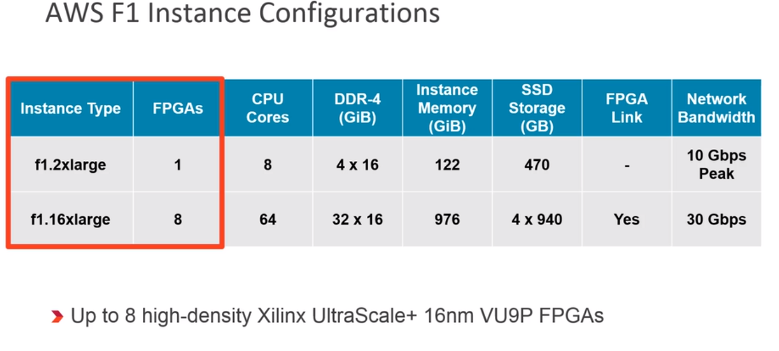

Slide 8
Create, Configure and Testing – AWS-F1
EC2 dashboard>Launch Instance> AMI (Amazon Machine Image)>FPGA Developer AMI>select f1.2xlarge instance.
Next: configure instance details>Add storage (default)>Add tags(default)>Configure Security Group.
Under security group Add Rule (in addition of SSH(default) : Type: RDP Protocol: TCP (default value) Port Range: 3389 (default value) Source: Custom - 0.0.0.0/0
Review and Launch Instance ( Make note of IPv4 Public DNS and Public IP address of the instance.)
Notes:
Medini

Slide 9
Create, Configure and Testing – AWS-F1
Connecting the Instance with the Remote Desktop Client : → Use PuTTy from command prompt to connect : putty -i <AWS key pairs.ppk> -ssh centos@<public IP address of EC2 instance> 22
<AWS key pairs> is the full path to the .pem (SSH) or .ppk (PuTTY) file containing the key pairs.
<public DNS of EC2 instance> is the Public DNS of the instance.
User name: centos ; connection type: SSH ; Port :22.
You are now connected to the EC2 Instance.
Notes:
Medini

Slide 10
Create, Configure and Testing – AWS-F1
Set up the GUI on the Instance : → The FPGA Developer AMI does not include a GUI desktop application → Install the Gnome window manager and start remote desktop protocol (RDP) services to allow remote desktop connections. “source <(curl -s https://s3.amazonaws.com/aws-fpga-developer-ami/1.5.0/Scripts/setup_gui.sh)” → User: Centos & Password: Generated by above script. →you will need to reboot your instance before connecting to the RDP client Machine. (IMPORTANT: Set your RDP client to use 24-bit for color depth & in RDP client, enter the IPv4 Public IP)
You are now connected to the instance running Centos 7 and the FPGA Developer AMI.
Notes:
Medini

Slide 11
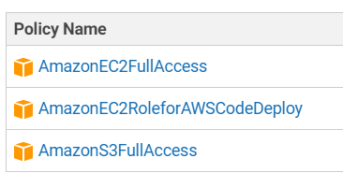
Create, Configure and Testing – AWS-F1
Configure the Instance for working with SDAccel: → In the RDP Client open a terminal. → Configure AWS CLI : $ aws configure AWS Access Key ID [None]: <your access key> AWS Secret Access Key [None]: <your secret key> Default region name [None]: <your AWS region > Default output format [None]: json
→ Before Configuring we must go to IAM > Create Group > add Users to the group > Set permissions ( under attach policy). → The above credentials can be found in AMI>Users>select user> credentials> create access key >(download the file containing the details) → Rest of the info : Region Name can be found in EC2 instance dashboard under description.
Notes:
Medini

Slide 12
Create, Configure and Testing – AWS-F1
Conti….. →User: Centos & Password: Generated by above script. →you will need to reboot your instance before connecting to the RDP client Machine. (IMPORTANT: Set your RDP client to use 24-bit for color depth & in RDP client, enter the IPv4 Public IP) You are now connected to the instance running Centos 7 and the FPGA Developer AMI.
Configure the SDAccel Environment : → Execute the following commands from the command line of the instance terminal: git clone https://github.com/aws/aws-fpga.git $AWS_FPGA_REPO_DIR cd $AWS_FPGA_REPO_DIR source sdaccel_setup.sh (first time you run it, the script will download the platform and compile the runtime and drivers. Subsequent runs are much faster. You must source sdaccel_setup.sh each time you open a new terminal)
Notes:
Medini

Slide 13
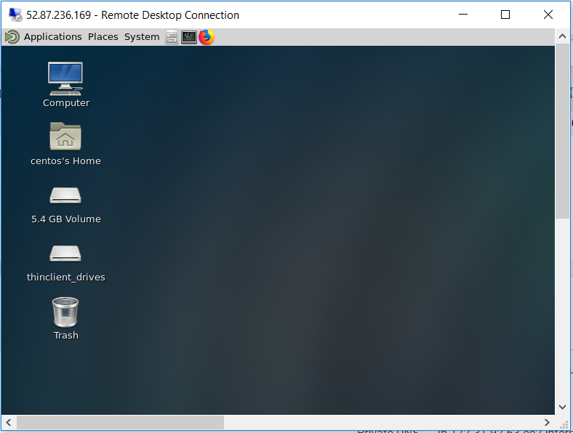
Testing & Demonstration – AWS
Connected to the RDP Client where the instance is running Centos 7 and the FPGA Developer AMI.
Notes:
Medini

Slide 14
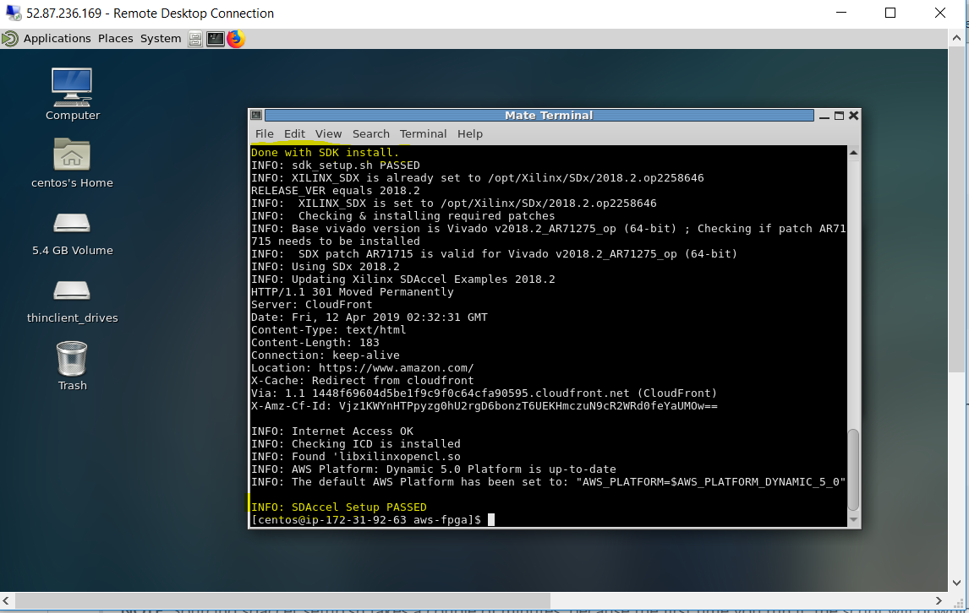
Testing & Demonstration – AWS
Notes:
Medini

Slide 15
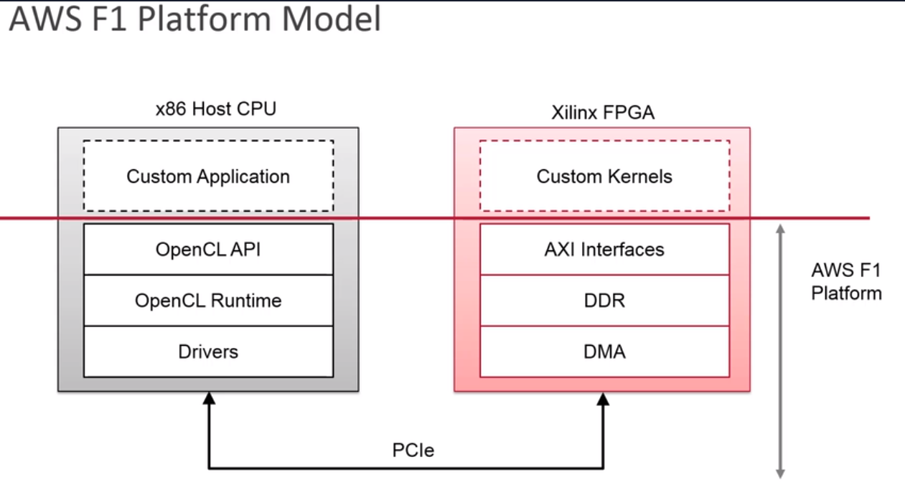

Slide 16
SDAccel – Download and Install.
The SDAccel emulation flows allows testing, profiling, and debugging the application before deploying it on F1.
https://www.xilinx.com/support/download/index.html/content/xilinx/en/downloadNav/sdaccel-development-environment.html
Download the web installer for Linux as the RTL Kernel is supported only on Linux environments.
Make it an executable using chmod and run the installer and follow the prompts.
Upgrade the Vivado Design suite to SD Accel development environment.
Notes:
Medini

Slide 17
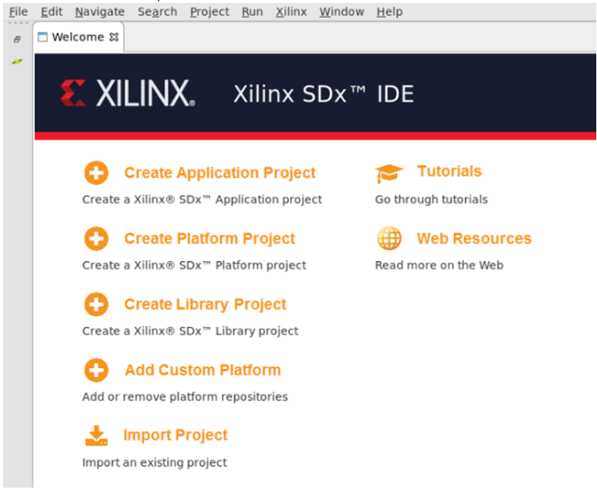

Slide 18
Set Up the Alveo U200 Accelerator Card
Download the Xilinx Runtime and Deployment and Development Shell to be able to interface with AWS F1. Then follow the Getting Started Guide.
https://www.xilinx.com/products/boards-and-kits/alveo/u200.html#gettingStarted
This will make the U200 platform available on the Local SDx suite.
Notes:
Medini

Slide 19
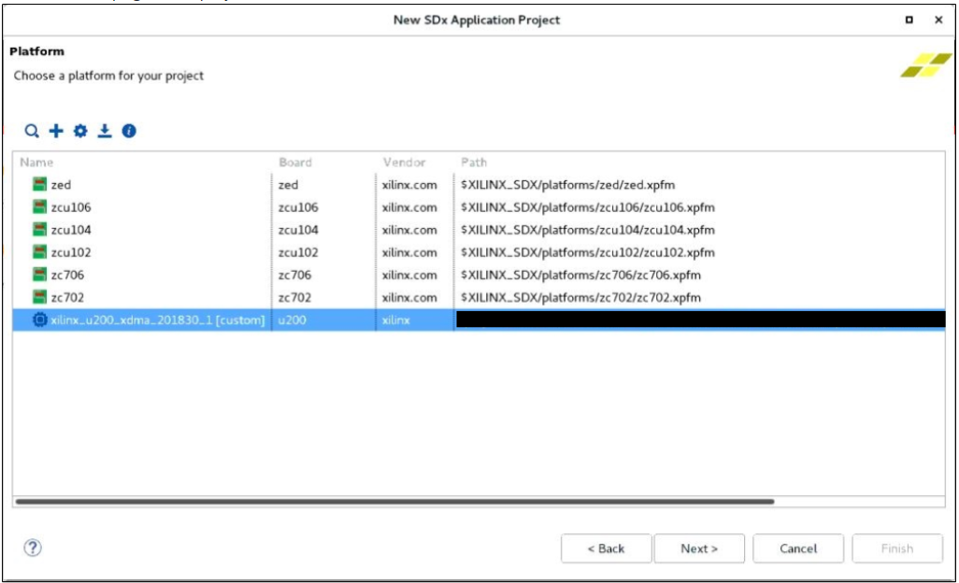

Slide 20
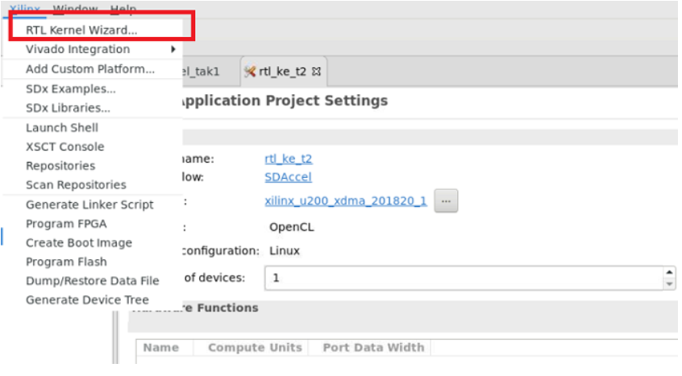
Implementation : Method 1 – RTL Kernel Wizard .

Slide 21
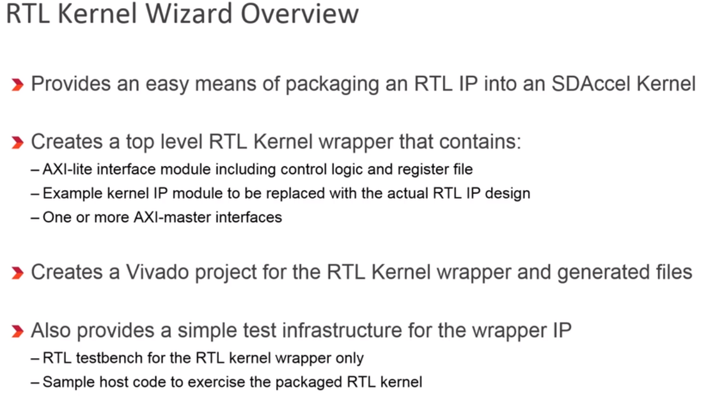
Notes:
Medini

Slide 22
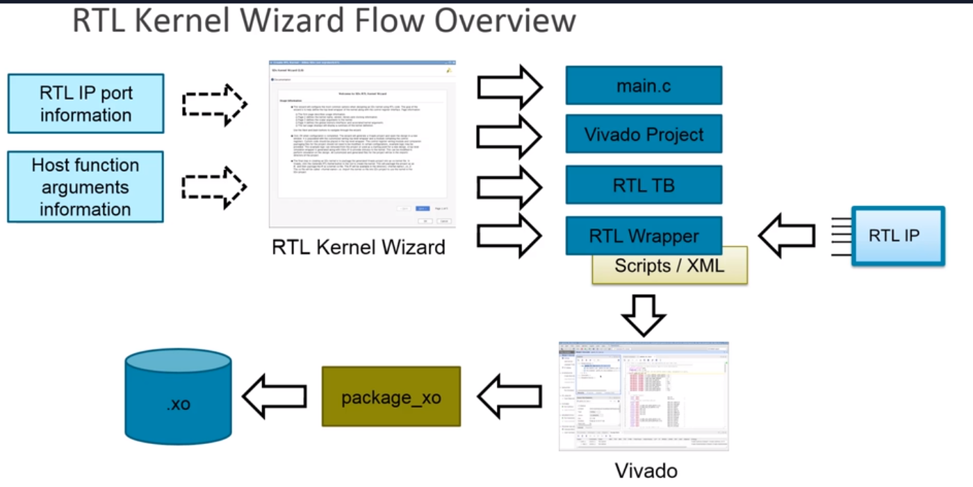
Notes:
Anushka

Slide 23
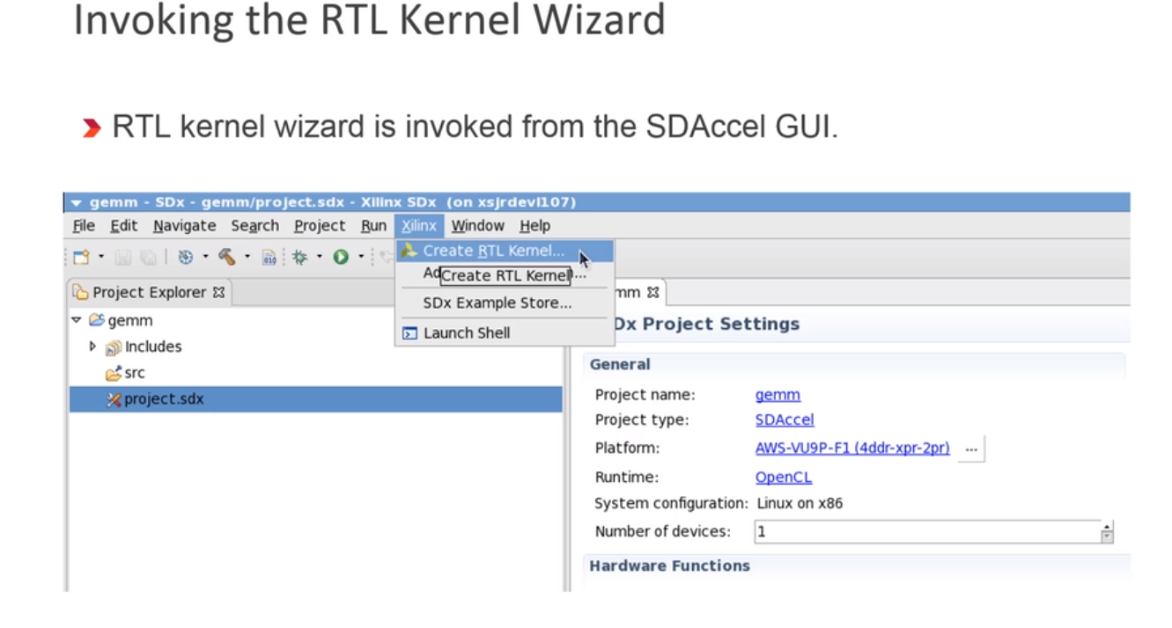
Notes:
Anushka

Slide 24
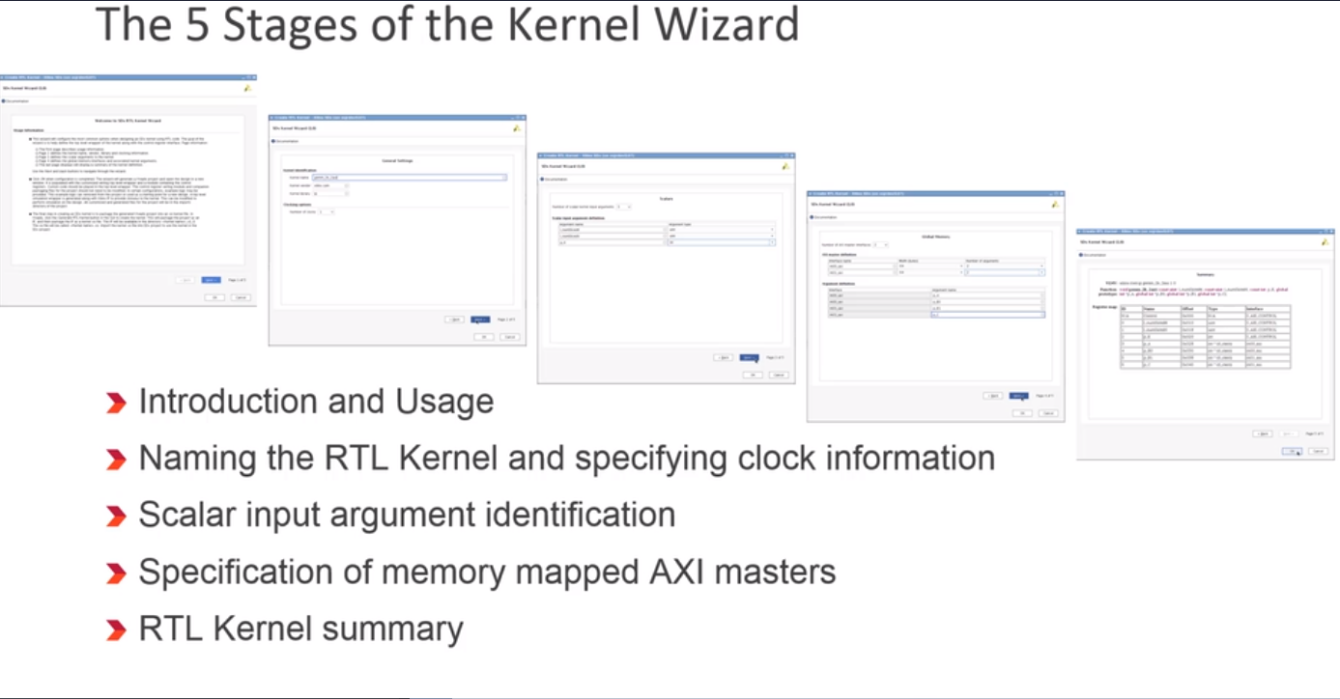

Slide 25
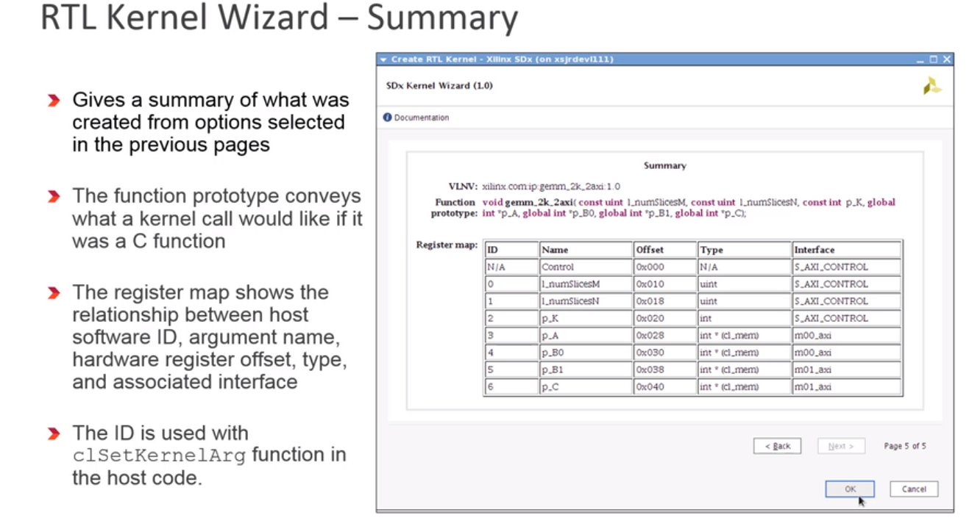

Slide 26
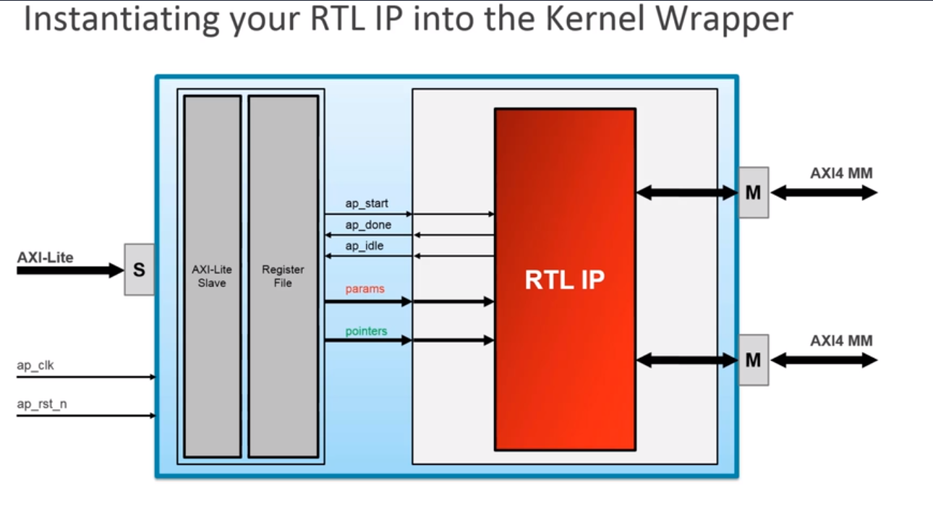
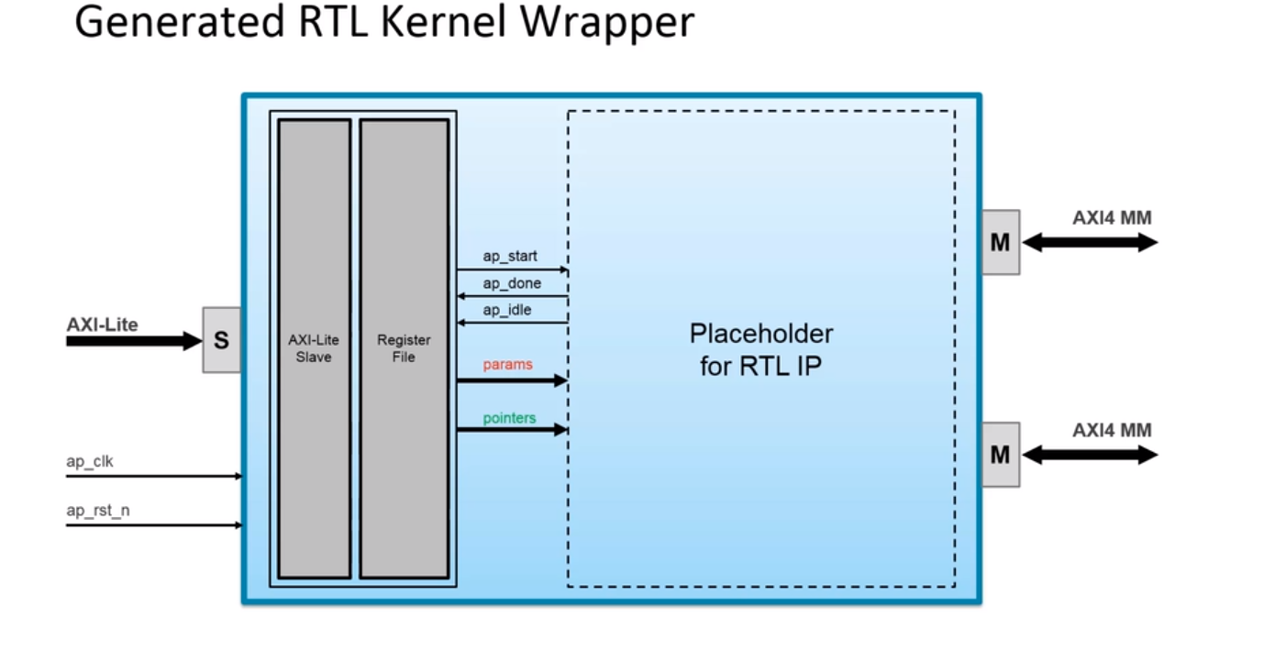

Slide 27
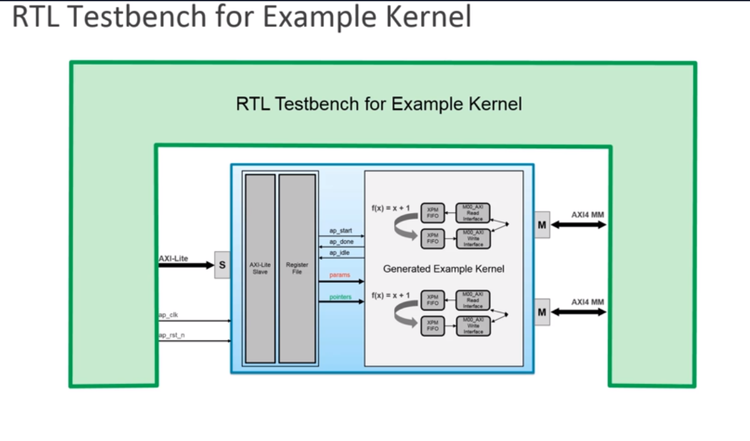

Slide 28
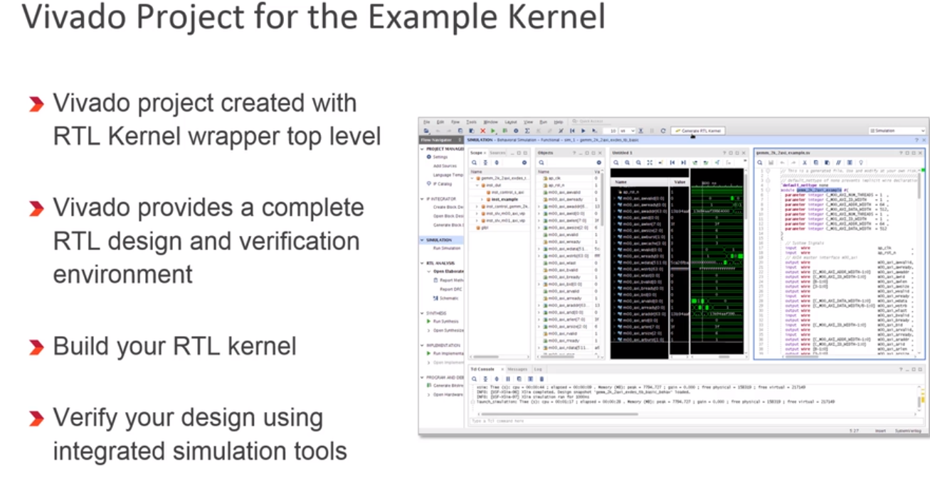

Slide 29
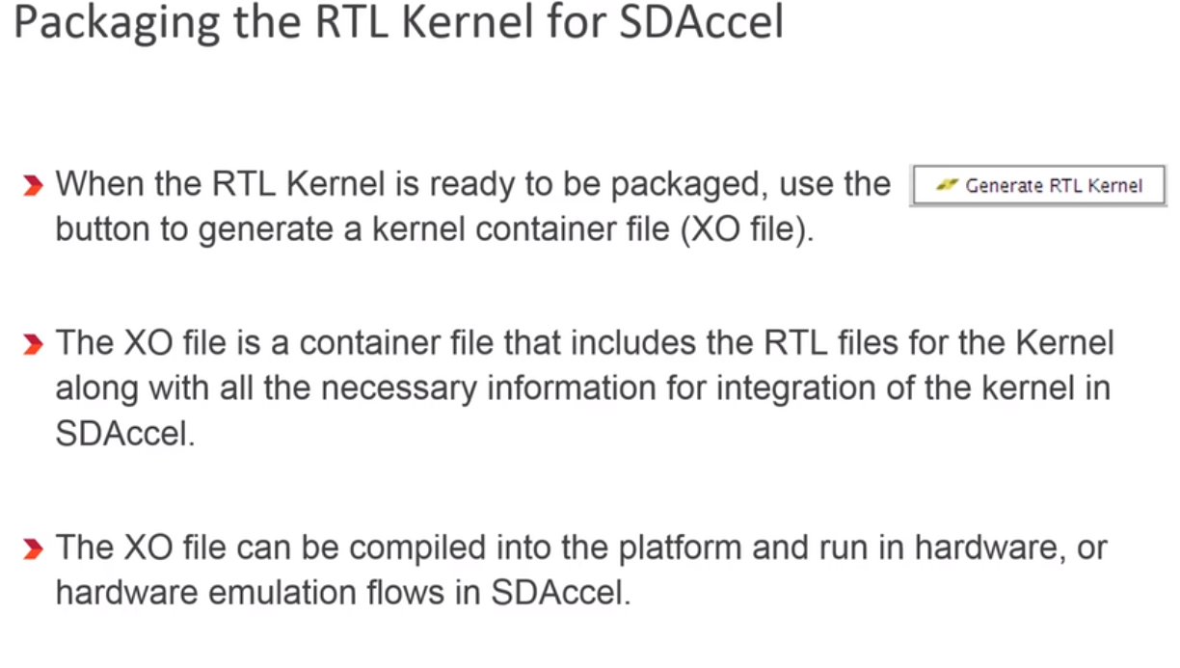

Slide 30
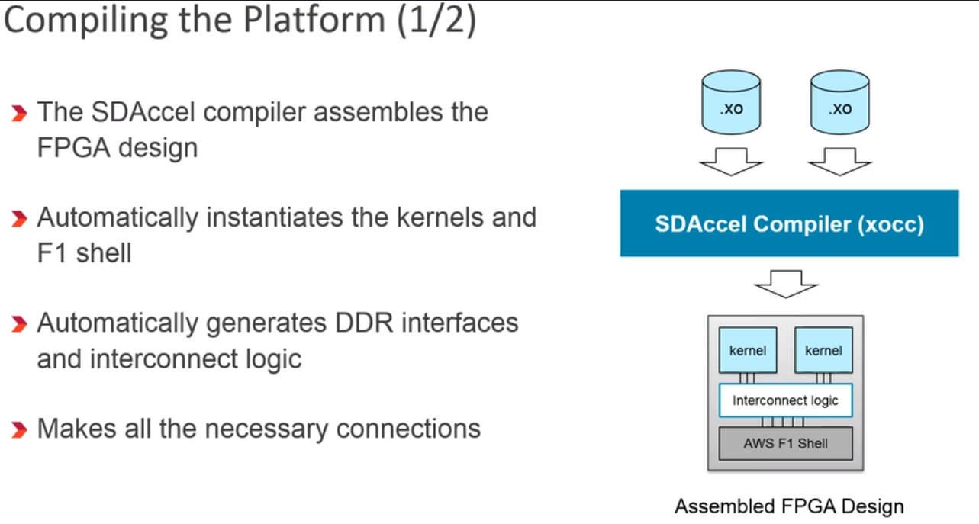

Slide 31
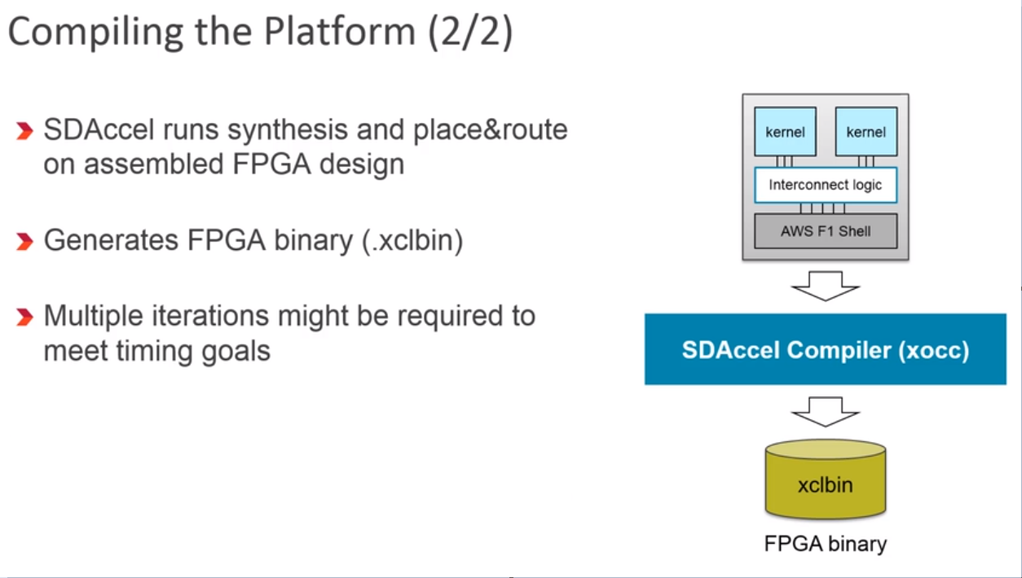

Slide 32
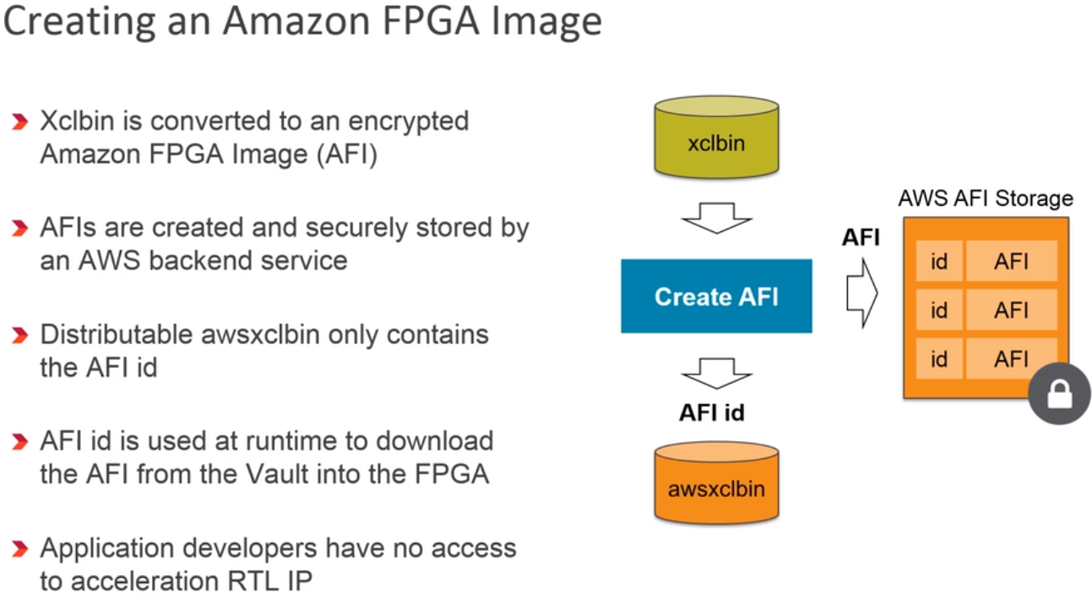

Slide 33
Implementation : Method 2 – Open CL implementation
There is an alternative method instead of integrating existing IP from Vivado.
SdAccel environment is compatible with open CL.
You can import an OpenCL implementation of the same project directly into SDAccel development Environment with the necessary files for processing.
Then compile : SW and HW emulation. to get the .xclbin files that you can then run on the FPGAs

Slide 34
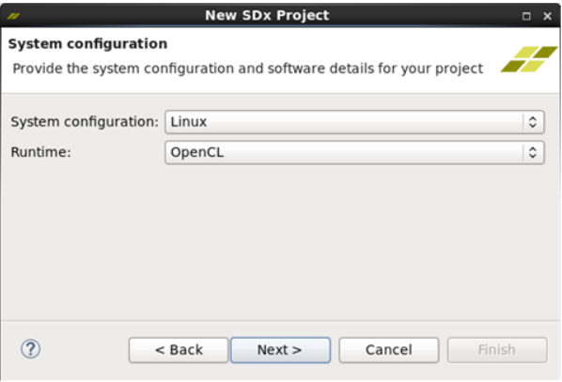
Process :
1) Create the SDx project like before and when prompted set the system configuration as follows :
2) Then select Empty Application to create a blank project.

Slide 35
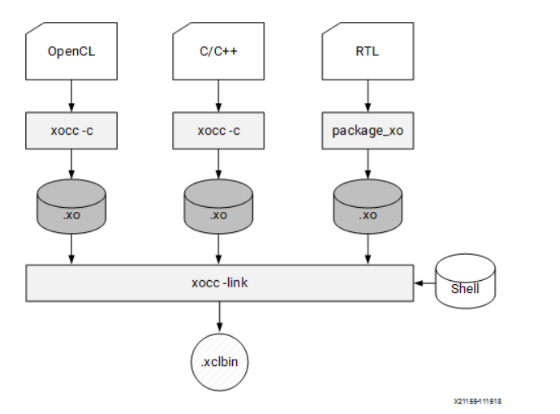
.xclbin file build process.
Host application build process using GCC: 1) Each host application source file is compiled to an object file (.o). 2) The object files (.o) are linked with the Xilinx SDAccel runtime shared library to create the executable (.exe).
FPGA build process is highlighted in the following figure:
Each kernel is independently compiled to a Xilinx object (.xo) file.

Slide 36
C/C++ and OpenCL C kernels are compiled for implementation on an FPGA using the xocc compiler. This step leverages the Vivado®HLS compiler.
RTL kernels are compiled using the package_xo utility. The RTL kernel wizard in the SDAccel environment can be used to simplify this process.
The kernel .xo files are linked with the hardware platform (shell) to create the FPGA binary (.xclbin).
When the build target is software or hardware emulation, as described below, xocc generates simulation models of the device contents.
When the build target is the system (actual hardware), xocc generates the FPGA binary for the device leveraging the Vivado Design Suite to run synthesis and implementation.

Slide 37
3) Import the necessary files for the project ( .ocl, .cpp, input files and binary files)
4) Run the Emulation to verify the functionality of both SW and HW then perform a system run to generate the file to run on the FPGA board.
Software Emulation (sw_emu)
Both the host application code and the kernel code are compiled to run on the x86 processor. This target is useful for identifying syntax errors, performing source-level debugging of the kernel code running together with application, and verifying the behavior of the system.
Hardware Emulation (hw_emu)
The kernel code is compiled into a hardware model (RTL) which is run in a dedicated simulator. This build and run loop takes longer but provides a detailed, cycle-accurate, view of kernel activity. This target is useful for testing the functionality of the logic that will go in the FPGA and for getting initial performance estimates.
System (hw)
The kernel code is compiled into a hardware model (RTL) and is then implemented on the FPGA device, resulting in a binary that will run on the actual FPGA.

Slide 38
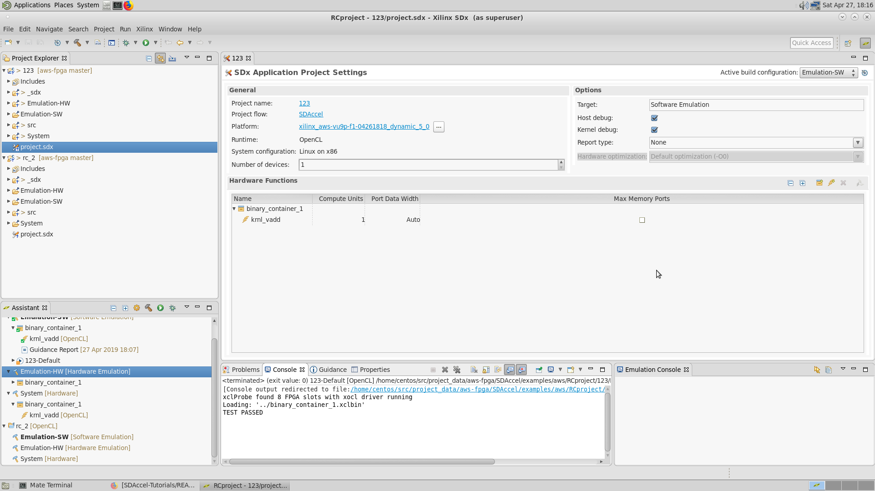
SDx Environment

Slide 39
Testing : (OpenCL Method Used)
Following commands can be sed to directly run the HW/SW and system runs for the project.
Software emulation :
$ cd $SDACCEL_DIR/examples/xilinx/getting_started/host/Project_name/
$ make clean
$ make check TARGETS=sw_emu DEVICES=$AWS_PLATFORM all
HW Emulation :
cd $SDACCEL_DIR/examples/xilinx/getting_started/host/Project_name/
$ make clean
$ make check TARGETS=hw_emu DEVICES=$AWS_PLATFORM all
Building the Host File and FPGA Binary: $ cd $SDACCEL_DIR/examples/xilinx/getting_started/host/Project_name/
$ make clean
$ make TARGETS=hw DEVICES=$AWS_PLATFORM all

Slide 40

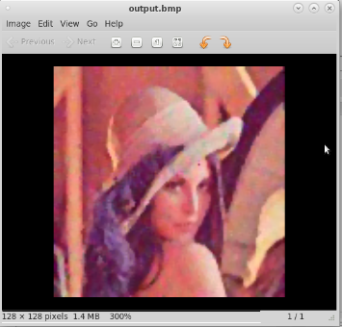

Project Work : Implementation of Median Filter on Zed Board and AWS
Original 128x128 bmp image
Salt and Pepper noise induced bmp image file taken as input (128x128)
Output 128x128 bmp image Executed on the AWS platform.

Slide 41
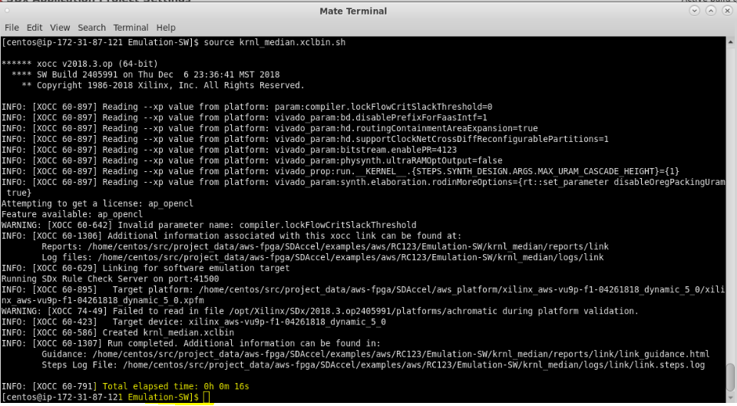
Screenshots of the SW & HW Emulation times
As observed in the last few statements the SW emulation is run in 16sec. This is inclusive of build time.

Slide 42
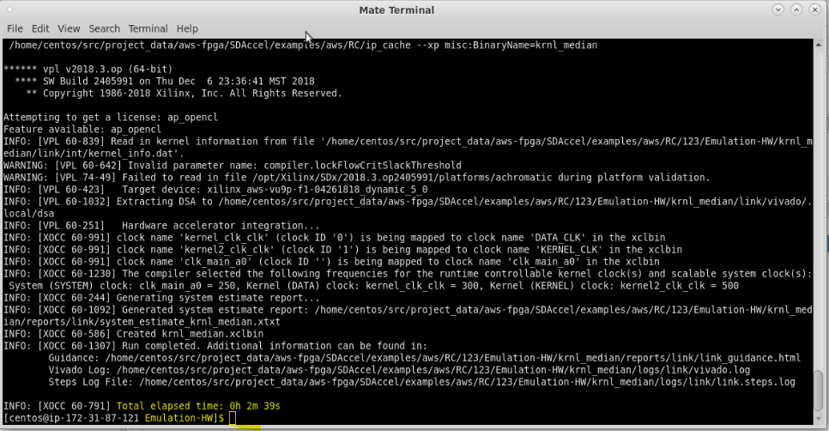
As observed in the last few statements the HW emulation is run in 2m 39sec. This is inclusive of build time which seems to be considerable in this case. ( HW implementation should have lower time than SW implementation )

